Slide 1
Recap
Introduction to objects
Private in Python
Objects with map and filter

Slide 2

Combining Objects

Slide 3
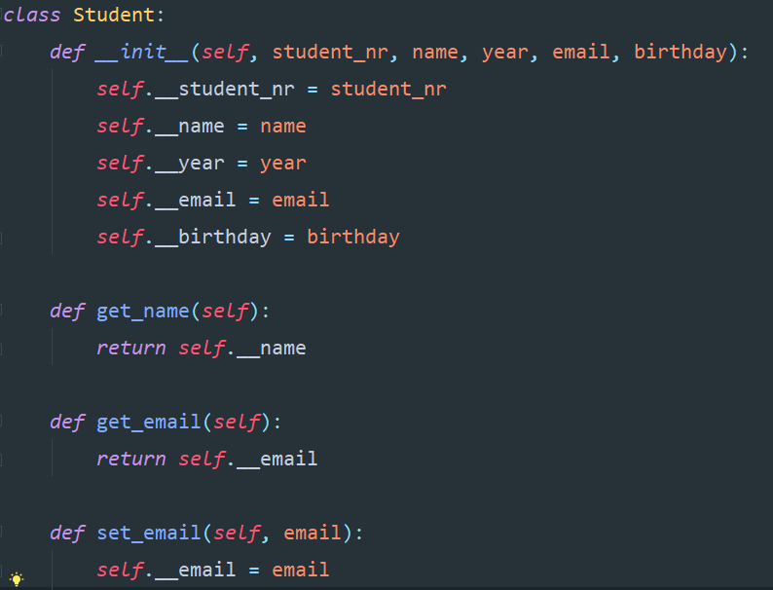
Example

Slide 4
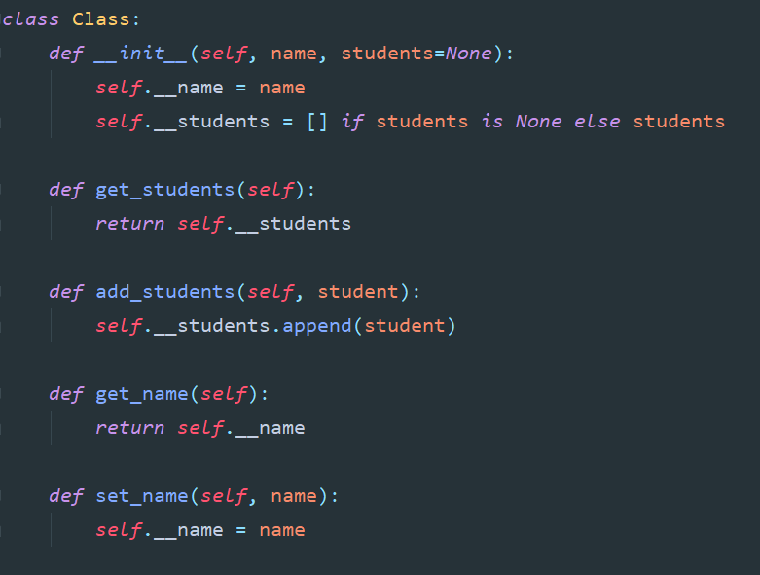
Example

Slide 5
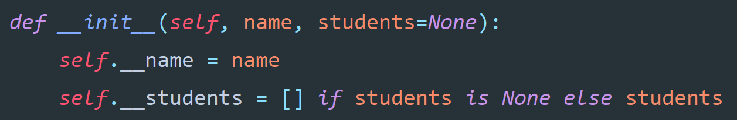
Example

Slide 6
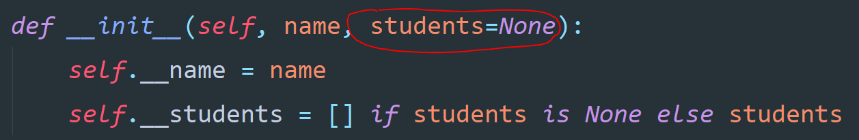
Example

Slide 7


Example

Slide 8
Example

Slide 9

Exercise
Create this class ->
Create a new function in which you create a new student in that Class

Slide 10
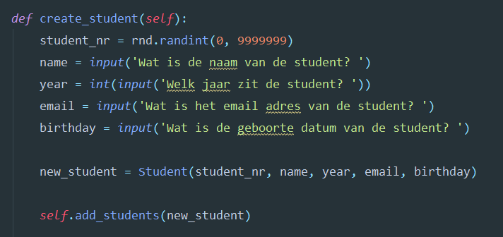
Exercise

Slide 11
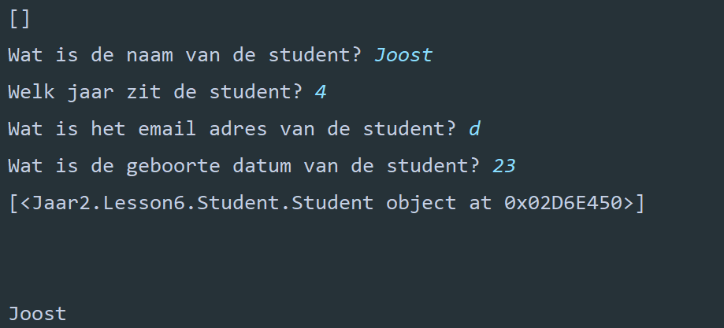
Exercise

Slide 12
Are there any questions

Slide 13
Let’s research Flask

Slide 14
Summary
Combining objects
Possibilities to ask questions about past weeks
Researched Flask

